Slide 1

Code for Good
Team 9
#4:Impact Measurement

Slide 2
Basic Challenges
Identified Solution
Defining the quantifiable parameters
Digitalization of the data collection and analysis
Social and economic impact assessment of the school
Creating reports and correlating outcomes of selected school with real stats.
Academics and demographic data
Data collection via forms and graphical analysis
Relative data and the success rate

Slide 3
Key Highlights
Partner registration/login
Periodic Data Updates
Pictographic representation of analyzed data
Accessibility on mouse-over
Interactive data representation

Slide 4
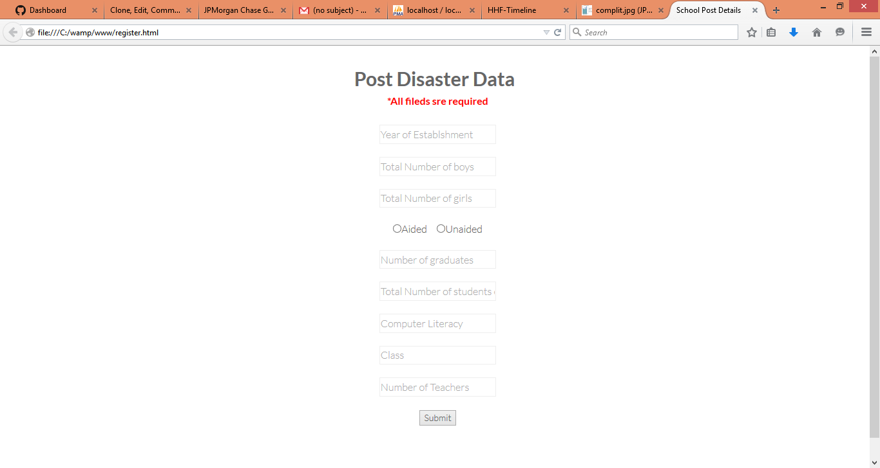

Slide 5
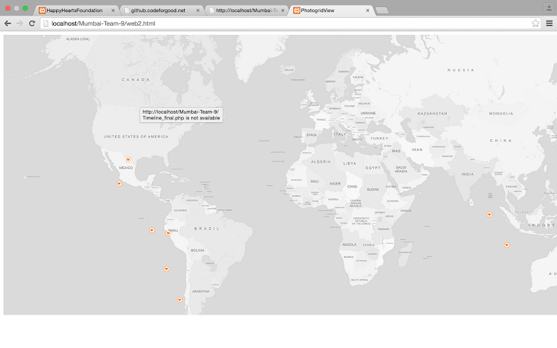

Slide 6
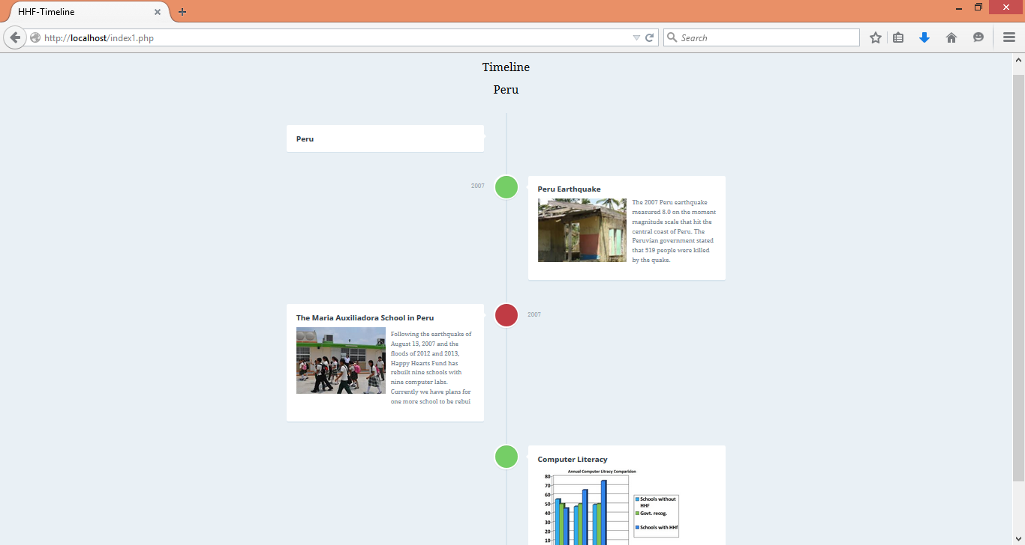

Slide 7
Road Ahead…
Dynamic representation of data
Modifying the database as per the improved parameters

Slide 8
Team Members
Servjeet Patil
Saloni Rane
Sejal Vyas
Tanveer Anand
Gaurav Deshpande
Vikas Gupta

